Slide 1
Introduction to JavaScript
Presented by: Manal Asghar

Slide 2
What is JavaScript?
JavaScript is a programming language used to make web pages interactive.
It runs inside web browsers.
It is used for:
Form validation
Animations
Games
Dynamic content updates
Works together with:
HTML (structure)
CSS (style)

Slide 3
What Can JavaScript Do?
JavaScript can:
Calculate and process data
Manipulate and validate user input
Dynamically update web pages
Control HTML and CSS

Slide 4
JavaScript & HTML Interaction
JavaScript can:
Find HTML elements using getElementById()
Change HTML content using innerHTML
document.getElementById("demo").innerHTML = "Hello JavaScript";
JavaScript accepts:
Double quotes " «
Single quotes ' '
JavaScript Quotes:

Slide 5
Changing HTML Attributes
JavaScript can modify HTML attributes such as:
Src
Href
Value
Example :
Turning a light bulb image ON and OFF

Slide 6
JavaScript & CSS Styling
JavaScript can change CSS styles dynamically.
document.getElementById("demo").style.fontSize = "35px";
JavaScript can hide elements by changing CSS display.
document.getElementById("demo").style.display = "none";
Hidden elements can be shown again
document.getElementById("demo").style.display = "block";
Hiding HTML Elements
Showing HTML Elements

Slide 7
JavaScript Where To
The <script> Tag
In HTML, JavaScript code is inserted between <script> and </script> tags.
You can place any number of scripts in an HTML document.
Scripts can be placed in the <body>, or in the <head> section of an HTML page, or in both
JavaScript in <head> or <body>

Slide 8
External JavaScript
Scripts can also be placed in external files:
External scripts are practical when the same code is used in many different web pages.
JavaScript files have the file extension .js
To use an external script, put the name of the script file in the src (source) attribute of a <script> tag:
<script src="myScript.js"></script>
External scripts cannot contain <script> tags.

Slide 9
JavaScript Output
JavaScript can "display" data in different ways:
Writing into an HTML element, using innerHTML or innerText.
Writing into the HTML output using document.write().
Writing into an alert box, using window.alert().
Writing into the browser console, using console.log().

Slide 10
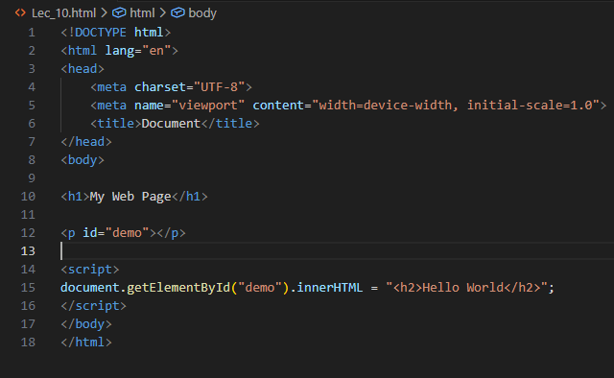
Using innerHTML
To access an HTML element, you can use the document.getElementById(id) method.
Use the id attribute to identify the HTML element.
Then use the innerHTML property to change the HTML content of the HTML element:

Slide 11
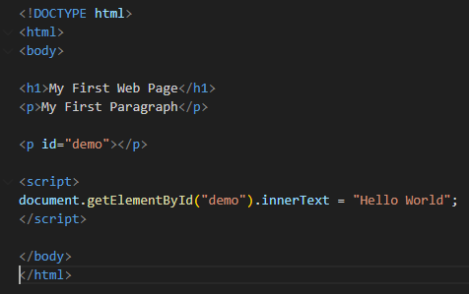
Using innerText
To access an HTML element, use the document.getElementById(id) method.
Then use the innerText property to change the inner text of the HTML element:

Slide 12
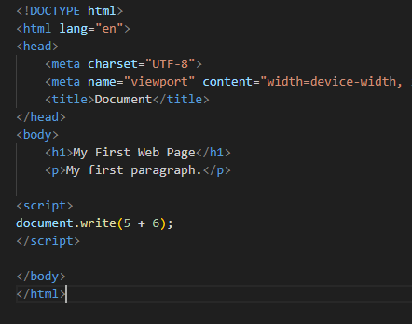
document.write().
For testing purposes, it is convenient to use document.write():
Using document.write() after an HTML document is loaded, will delete all existing HTML:
The document.write() method should only be used for testing.

Slide 13
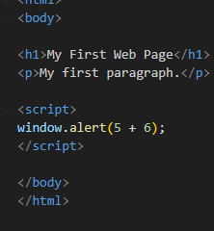
Window.alert().
You can use an alert box to display data:
In JavaScript, the window object is the global scope object.
This means that variables, properties, and methods by default belong to the window object.
This also means that specifying the window keyword is optional:

Slide 14
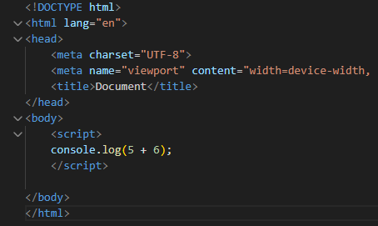
Console.log().
For debugging purposes, you can call the console.log() method in the browser to display data.

Slide 15
JavaScript Values
The JavaScript syntax defines two types of values:
Literals (Fixed values)
Variables (Variable values)
JavaScript Literals
The most important syntax rules for literals (fixed values) are:
Numbers are written with or without decimals: 10.5 , 1001
Strings are text, written within double or single quotes: "John Doe“
JavaScript Keywords
JavaScript keywords are used to defines actions to be performed.
The let and const keywords create variables:
let x = 5;
const fname = "John";

Slide 16
JavaScript Identifiers
Variables are identified with unique names called identifiers.
An identifier is the name you give to a variable.
Rules for identifiers:
Must start with a letter, _, or $
Can contain digits after the first character
Cannot be a reserved keyword (let, const, if, etc.)
Are case-sensitive

Slide 17
JavaScript Statements
let x, y, z; // Statement 1
x = 5; // Statement 2
y = 6; // Statement 3
z = x + y; // Statement 4
JavaScript statements are composed of:
Values, Operators, Expressions, Keywords, and Comments.
This statement tells the browser to write "Hello Dolly." inside an HTML element with id="demo":
Semicolons separate JavaScript statements.
Add a semicolon at the end of each executable statement:

Slide 18
JavaScript White Space
JavaScript ignores multiple spaces. You can add white space to your script to make it more readable.
The following lines are equivalent:
let person = "Hege";
let person="Hege";

Slide 19
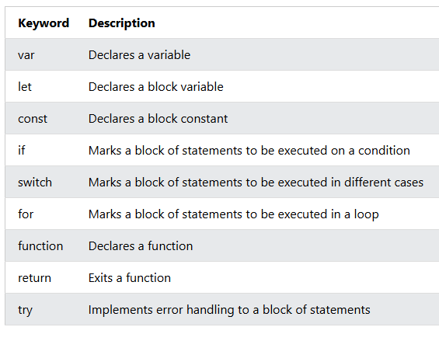
JavaScript Keywords
JavaScript keywords are reserved words. Reserved words cannot be used as names for variables.

Slide 20
JavaScript Variables
Variables = Data Containers
JavaScript variables are containers for data.
JavaScript variables can be declared in 4 ways:
Modern JavaScript
Using let
Using const
Older JavaScript
Using var (Not Recommended)
Automatically (Not Recommended)

Slide 21
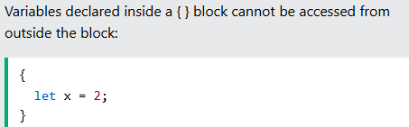
JavaScript Let
The let keyword was introduced in ES6 (2015)
Variables declared with let have Block Scope
Variables declared with let must be Declared before use
Variables declared with let cannot be Redeclared in the same scope.
Block Scope:
Before ES6 (2015), JavaScript did not have Block Scope.
JavaScript had Global Scope and Function Scope.
ES6 introduced the two new JavaScript keywords: let and const.
These two keywords provided Block Scope in JavaScript:

Slide 22
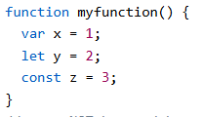
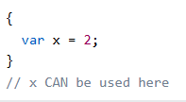
Function Scope:
Inside a function all variables declared with var, let or const have Function Scope.
All of these cannot be used outside the function.
Global Scope
Variables declared with the var always have Global Scope.
Variables declared with the var keyword can NOT have block scope:

Slide 23
Data Types
Primitive Types:
Number: 10, 3.14
String: "Hello“
Boolean: true / false
Undefined, Null, Symbol
Non-Primitive:
Object, Array, Function

Slide 24
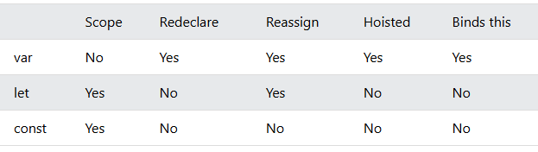
Difference between var, let , const

Slide 25
JavaScript Operators
Arithmetic: + - * / %
Assignment: =, +=, -=
Comparison: ==, ===, !=, <, >
Logical: &&, ||, !

Slide 26
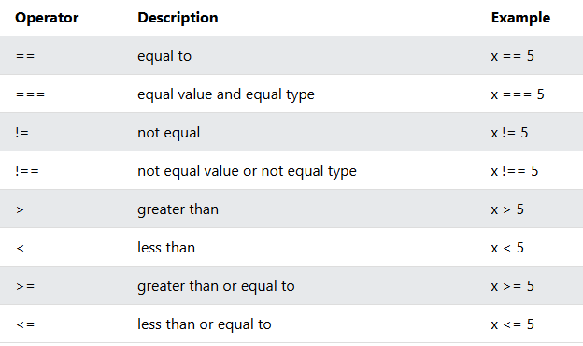
JavaScript Operators
Operators are for Mathematical and Logical Computations
The Assignment Operator = assigns values
The Addition Operator + adds values
The Multiplication Operator * multiplies values
The Comparison Operator > compares values

Slide 27
Conditional Statements
Conditional Statements allow us to perform different actions for different conditions.
Conditional statements run different code depending on true or false conditions.
Conditional statements include:
if
if...else
if...else if...else
switch

Slide 28
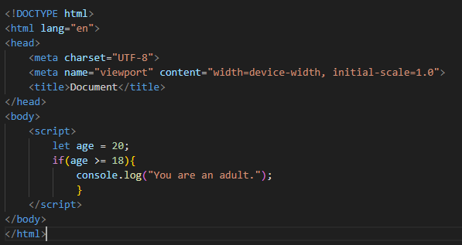
Conditional Statements
if Statement:

Slide 29
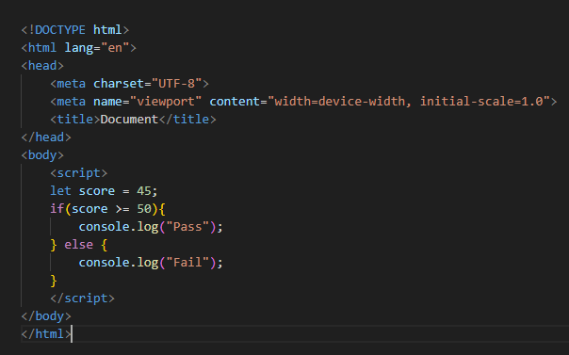
Conditional Statements
if-else Statement:

Slide 30
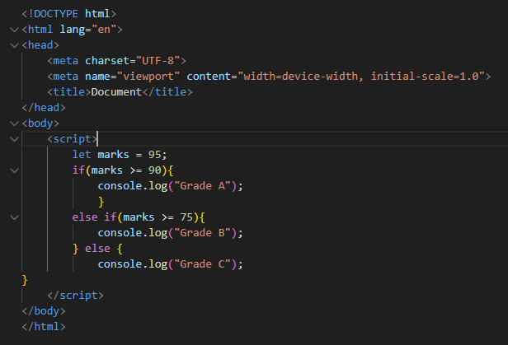
Conditional Statements
if-else if-else:

Slide 31
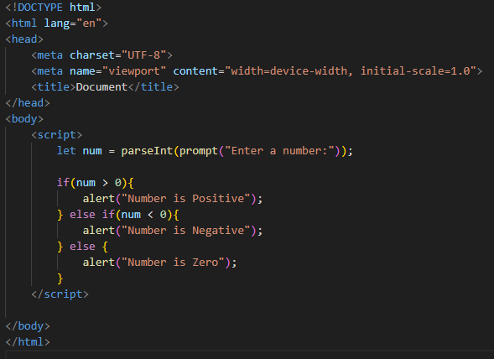
Practical: Number Checker

Slide 32
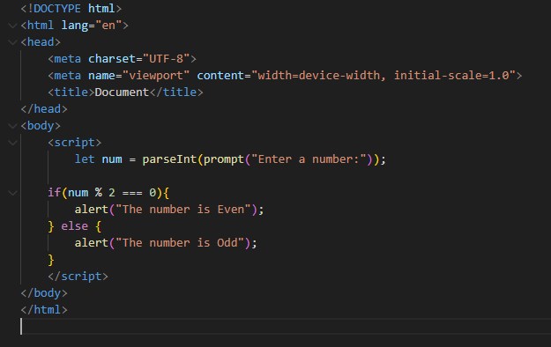
Even or Odd Number Checker

Slide 33
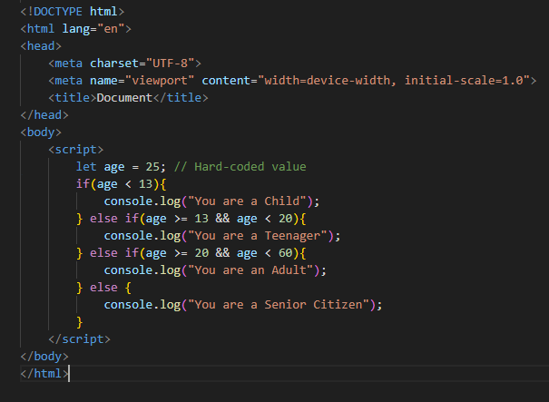
Age Group Classification

Slide 34
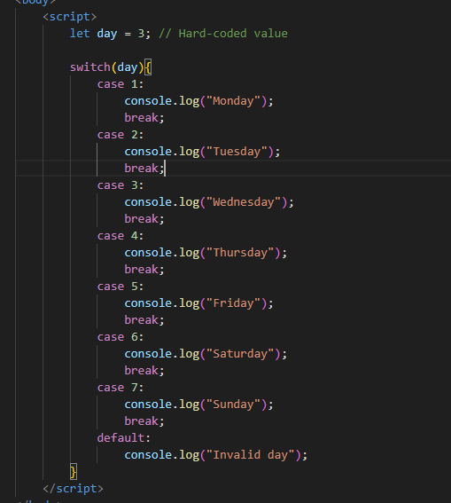
Switch Statement
Use switch to specify many alternative code blocks to be executed.

Slide 35
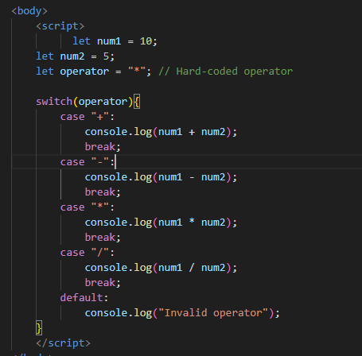
Switch Statement (calculator)

Slide 36
Loops
Loops are handy, if you want to run the same code over and over again, each time with a different value.
Loops allow code to repeat multiple times until a condition is met.
Types of Loops:
For
While
do...while

Slide 37
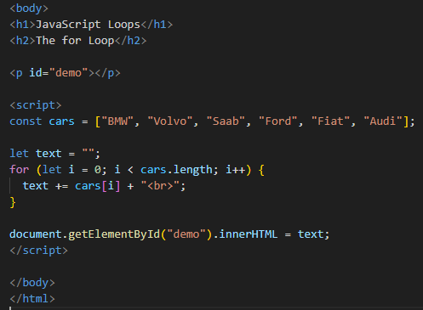
For loop:
The for statement creates a loop with 3 optional expressions:
for (expr1; expr2; expr) {
// code block to be executed
}
exp1 is executed one time before the execution of the code block.
exp2 defines the condition for executing the code block.
exp3 is executed every time the code block has been executed.

Slide 38


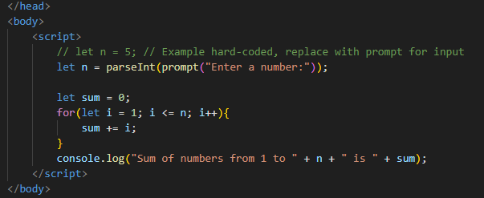
Print numbers 1 to 5
Multiply Numbers by 2
Sum of Numbers up to User Input

Slide 39
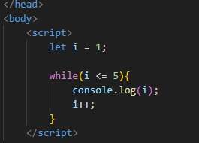
The While Loop
The while loop loops through a block of code as long as a specified condition is true.

Slide 40
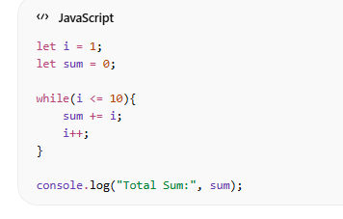
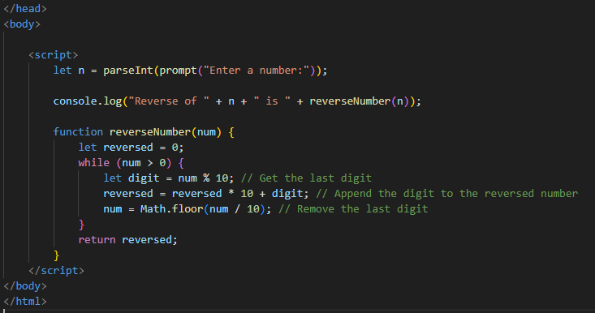
Practice
Sum of First 10 Numbers
Reverse countdown

